Slide 1


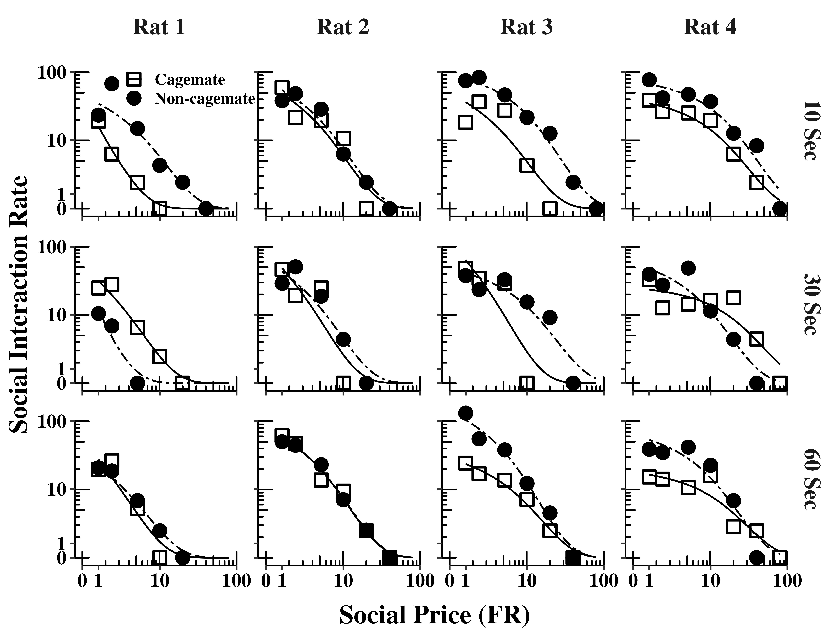
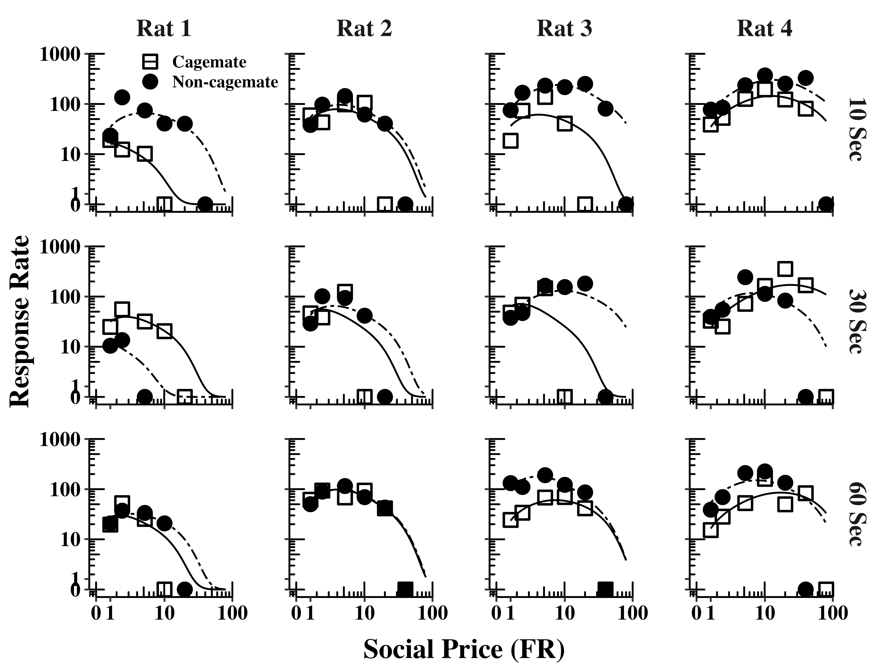
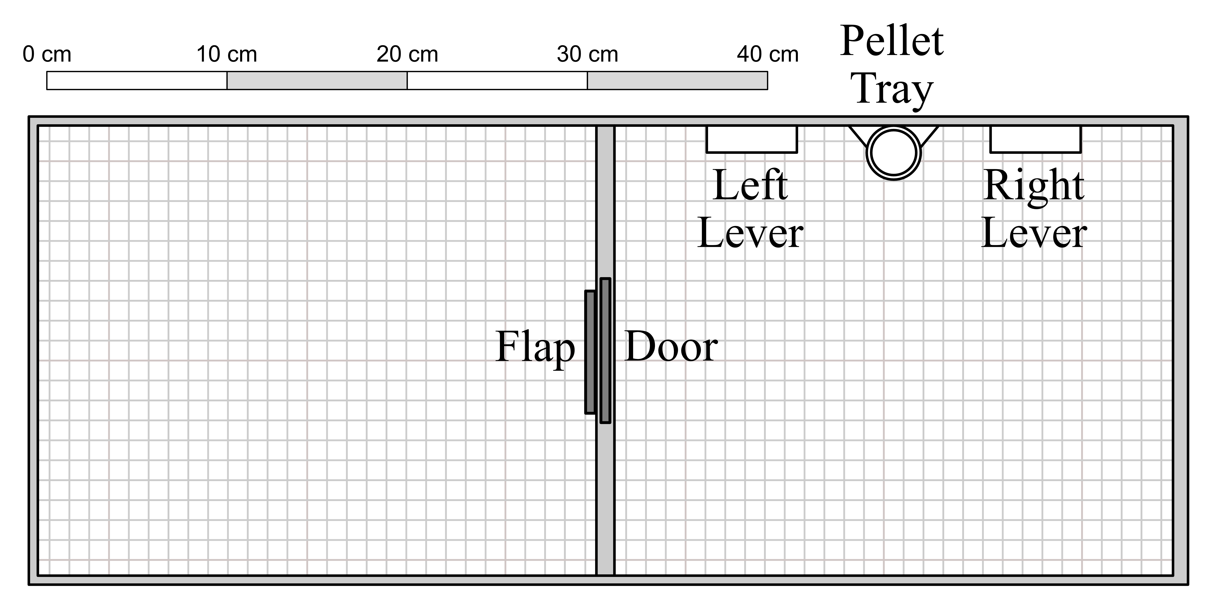
Social familiarity and reinforcement value: A behavioral-economic analysis of demand for social interaction in rats with cagemate and non-cagemate female rats
Haoran Wan^{1,2}, Rachel Schulingkamp¹, and Tim Hackenberg¹
¹Department of Psychology, Reed College, ²Psychological & Brian Sciences, Washington University in St. Louis
Introduction
Results
Social interaction serves key adaptive functions at various stages of development and social reinforcement (i.e., contingent access to social interaction) has been observed in a variety of species.
Though previous research observed a consistent preference for the non-cagemate, social preferences for the non-cagemate rat might not be reflected in the demand-based methods.
The present study examined demand for social interaction separately for cagemate and non-cagemate rats over extended time and with procedures permitting direct contact between rats.
Method
Subject. Four experimentally naïve rats from different cages were arbitrarily assigned as focal rats and the other eight rats as social target rats.
Procedure. Demand functions were generated by increasing the FR price across conditions at each of three different social interaction durations (10 s, 30 s, and 60 s), first with cagemate rats and then with non-cagemate rats as social targets.
Analysis. Social interaction rate was modeled using the Zero-Bounded Exponential model, generating six separate curves per rat: three for social interaction duration (10, 30, and 60s) under each of two familiarity conditions (cagemate or non-cagemate).
None of the main parameters of the model varied systematically with social interaction duration or with the social familiarity of the partner rat.
Conclusions
The rate at which social interaction was produced declined systematically with price, consistent with the law of demand, and with a growing body of research aimed at quantifying social reinforcement effects.
Despite the strong sensitivity to social interaction price, we did not find systematic effects of social familiarity: Demand and response output for cagemate rats did not differ appreciably from demand and response output for non-cagemate rats.
We also found no consistent effect of social interaction duration: There were no significant differences in the main parameters of the model across the three durations.
We found that opportunities for social interaction served as effective reinforcers for rats, adding to an expanding literature on social reinforcement effects in rodents.
Standardized methods for analyzing and quantifying social motivation, like those used in the present study, should prove especially valuable tools in building the types of predictive testable models needed for an integrated cross-species approach to social behavior.

